Slide 1

Competitive Programming From Problem 2 Solution in O(1)
P
T
H
I
N
K
F
A
S
T
S
C++: Repetition
Mostafa Saad Ibrahim
Teaching Assistant @ Cairo University

Slide 2
How to
Avoid goto statements, but could do retrials?
Sum numbers from 1 to 1000?
Search for a bank account using account number?
And so on... => Repetition mechnisms
While, do while, for

Slide 3
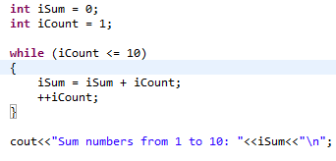

while Statement: sum 1-10

Slide 4
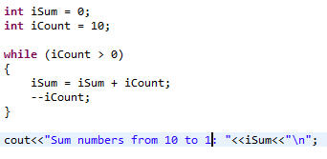

while Statement: sum 10-1

Slide 5
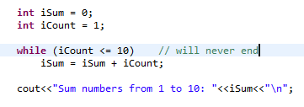
while Statement: infinite loop

Slide 6
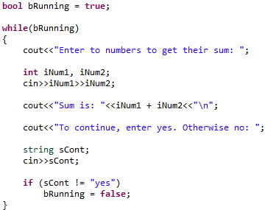
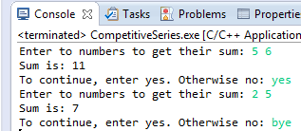
while Statement: retrial

Slide 7
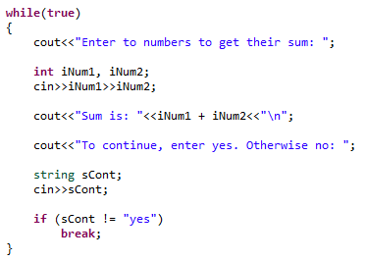
while + break statement

Slide 8
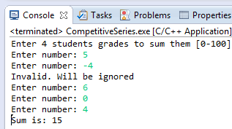
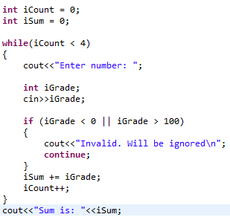
while + continue statement

Slide 9
For statement
Same purpose as while
Different format
Helpful for fixed increment

Slide 10
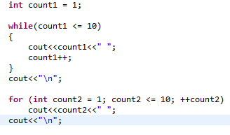
For vs While

Slide 11
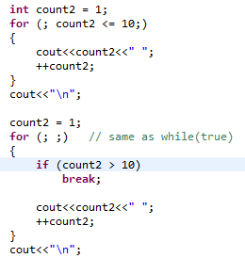
For empty parts

Slide 12
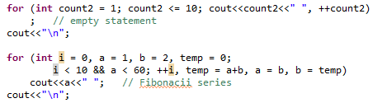

More on For Parts

Slide 13

Nested 4 loops

Slide 14
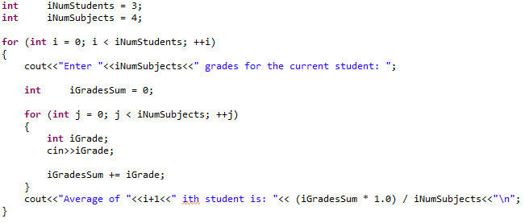

For Example

Slide 15
Do-while Statement
For and While validate first, then do body
Body minimum evaluated zero times
Do-while do body first, then validate
Body minimum evaluated once
Whenever you MUST do the first step, do-while more convenient. Less usage in real life.

Slide 16
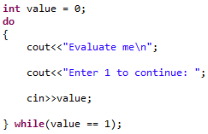

Do-while Statement

Slide 17
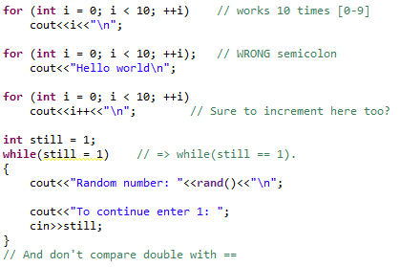
Common Errors

Slide 18
Finally
90% of your code will be repetition!
Practice 2+ days on this topic. Pick a book and solve all its excercises
Think/Write a big code that needs much looping
Practice... Practice... Practice........OO

